Slide 1


Department of BES-1
DaTA STRUCTURE
24sc120
Topic:
Prim’s Minimum Spanning Tree (MST)
Session - 38

Slide 2



AIM OF THE SESSION
To familiarize students with the concept of Prim’s minimum Spanning Tree.
INSTRUCTIONAL OBJECTIVES
This Session is designed to:
Demonstrate :- Minimum Spanning tree and its type.
Describe :- Prim’s Algorithm and calculating MST using Prim’s algorithm.
LEARNING OUTCOMES
At the end of this session, you should be able to:
Define :- Minimum Spanning tree and its types
Describe :- Prim’s Algorithm
Summarize:- How to calculate MST with Prim’s Algorithm.

Slide 3
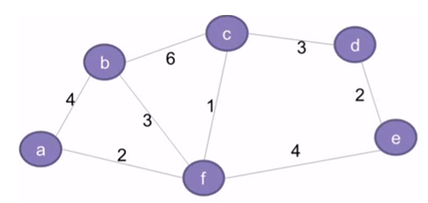
Minimum spanning tree
A minimum spanning tree (MST) is a spanning tree that has a weight that is equal to or less than all of the other spanning trees in a weighted, connected, undirected graph.

Slide 4
Spanning tree
A spanning tree is a subset of Graph G, such that all the vertices are connected using minimum possible number of edges.
Hence, a spanning tree does not have cycles and a graph may have more than one spanning tree.

Slide 5
General Properties of Spanning Tree
Removing one edge from Spanning Tree will make it disconnected.
Adding one edge to the Spanning Tree will create a loop.
If each edge has distinct weights, then there will be only one unique MST.
If each edge has few same weights, then there will be more than 2 MSTs.
A complete and undirected graph contains n^{n-2} spanning trees.
Connected and Undirected graph contains 1 Spanning Tree.

Slide 6
Algorithm
1) Create a set mstSet that keeps track of vertices already included in MST.
2) Assign a key value to all vertices in the input graph. Initialize all key values as INFINITE. Assign key value as 0 for the first vertex so that it is picked first.
3) While mstSet doesn’t include all vertices
----Pick a vertex u which is not there in mstSet and has minimum key value.
----Include u to mstSet.
----Update key value of all adjacent vertices of u. To update the key values, iterate through all adjacent vertices. For every adjacent vertex v, if weight of edge u-v is less than the previous key value of v, update the key value as weight of u-v

Slide 7
The idea of using key values is to pick the minimum weight edge from cut.
The key values are used only for vertices which are not yet included in MST, the key value for these vertices indicate the minimum weight edges connecting them to the set of vertices included in MST.

Slide 8
SESSION DESCRIPTION (Cont..)
Prim’s algorithm
Kruskal’s algorithm
Applications
Used to construct trees for broadcasting in computer networks.
Used in graph-based cluster analysis.
Used in image segmentation.
Used in regionalisation of socio-geographic areas, where regions are grouped into contiguous regions.

Slide 9
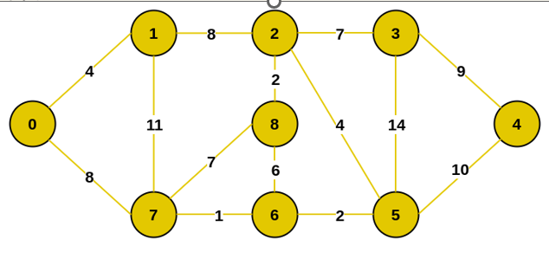
Prim’s Algorithm (Example)
Let us understand with the following example:

Slide 10
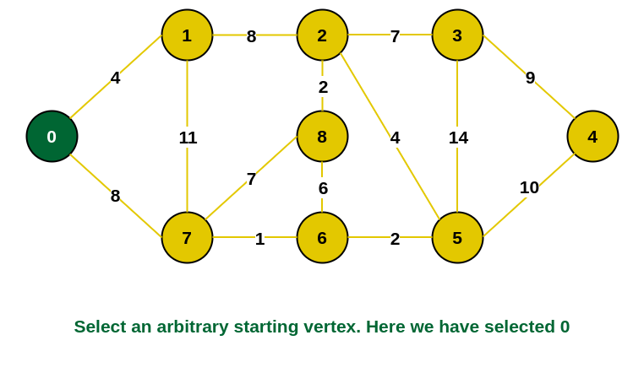
Prim’s Algorithm (Example conti..)
Step 1: Firstly, we select an arbitrary vertex that acts as the starting vertex of the
Minimum Spanning Tree. Here we have selected vertex 0 as the starting vertex.

Slide 11
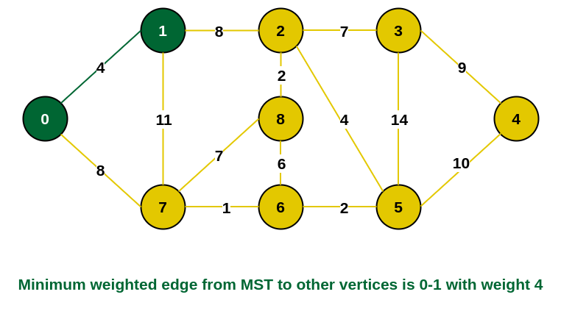
Prim’s Algorithm (Example conti..)
Step 2: All the edges connecting the incomplete MST and other vertices are
the edges {0, 1} and {0, 7}. Between these two the edge with minimum
weight is {0, 1}. So include the edge and vertex 1 in the MST.

Slide 12
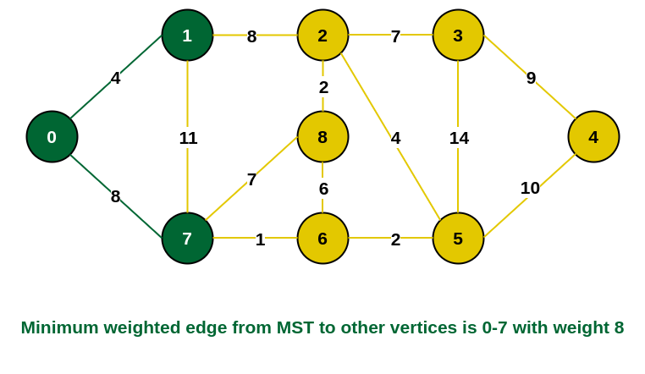
Prim’s Algorithm (Example conti..)
Step 3: The edges connecting the incomplete MST to other vertices are {0, 7}, {1, 7}
and {1, 2}. Among these edges the minimum weight is 8 which is of the edges {0, 7}
and {1, 2}. Let us here include the edge {0, 7} and the vertex 7 in the MST. [We could
have also included edge {1, 2} and vertex 2 in the MST].

Slide 13
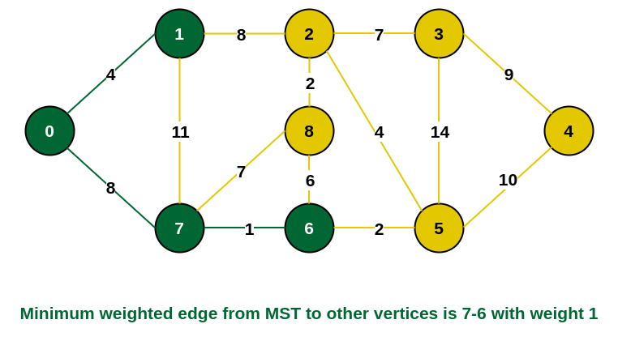
Prim’s Algorithm (Example conti..)
Step 4: The edges that connect the incomplete MST with the fringe vertices are {1, 2}, {7, 6} and {7, 8}. Add the edge {7, 6} and the vertex 6 in the MST as it has the least weight (i.e., 1).

Slide 14
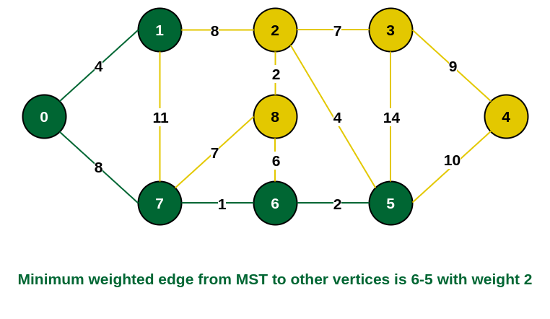
Prim’s Algorithm (Example conti..)
Step 5: The connecting edges now are {7, 8}, {1, 2}, {6, 8} and {6, 5}. Include
edge {6, 5} and vertex 5 in the MST as the edge has the minimum weight (i.e., 2)
among them

Slide 15
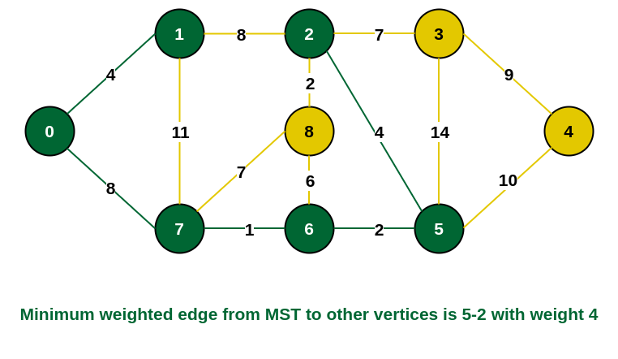
Prim’s Algorithm (Example conti..)
Step 6: Among the current connecting edges, the edge {5, 2} has the minimum
weight. So include that edge and the vertex 2 in the MST.

Slide 16
Prim’s Algorithm (Example conti..)
Step 7: The connecting edges between the incomplete MST and the other edges are
{2, 8}, {2, 3}, {5, 3} and {5, 4}. The edge with minimum weight is edge {2, 8}
which has weight 2. So include this edge and the vertex 8 in the MST.

Slide 17
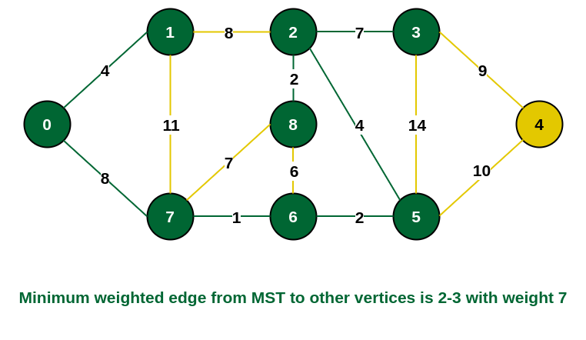
Prim’s Algorithm (Example conti..)
Step 8: See here that the edges {7, 8} and {2, 3} both have same weight which are
minimum. But 7 is already part of MST. So we will consider the edge {2, 3} and
include that edge and vertex 3 in the MST.

Slide 18
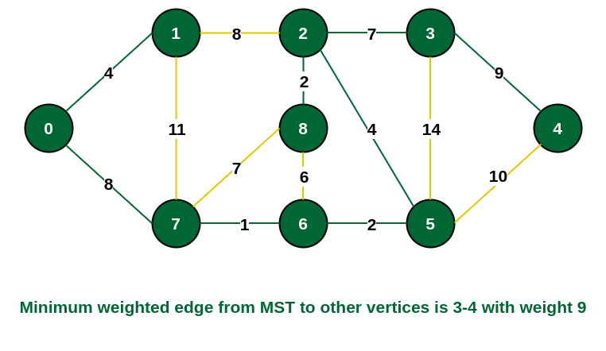
Prim’s Algorithm (Example conti..)
Step 9: Only the vertex 4 remains to be included. The minimum weighted edge from the incomplete MST to 4 is {3, 4}.

Slide 19
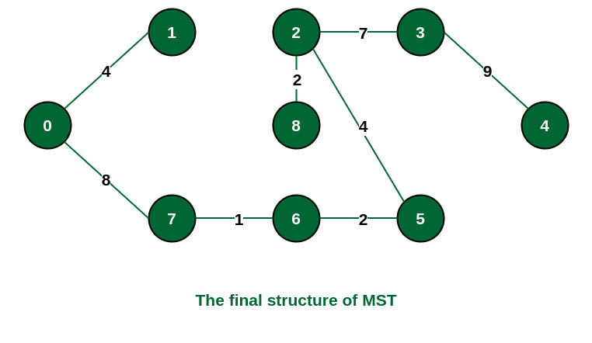
Prim’s Algorithm (Example conti..)
The final structure of the MST is as follows and the weight of the edges of the MST
is (4 + 8 + 1 + 2 + 4 + 2 + 7 + 9) = 37.

Slide 20
SUMMARY
Prim's technique works on the simple principle that all vertices in a spanning tree must be connected. To build a Spanning Tree, the two distinct subsets of vertices should be joined and they must be connected in such a way that summation of all edge weights is minimum.

Slide 21
SELF-ASSESSMENT QUESTIONS
Prim’s algorithm is a ______
Divide and conquer algorithm
Greedy algorithm
Dynamic Programming
Approximation algorithm
2. Prim’s algorithm can be efficiently implemented using _____ for graphs with greater density.
d-ary heap
linear search
fibonacci heap
binary search

Slide 22
TERMINAL QUESTIONS
1. Describe the minimum cost of a Spanning tree using Prim’s Algorithm?
2. List out the steps involved in Prim’s Algorithm?
3. Analyze the implementation details of minimum spanning tree using Prim’s Algorithm?
4. Summarize the concept of Prim’s Minimum Spanning Tree?

Slide 23
REFERENCES FOR FURTHER LEARNING OF THE SESSION
Reference Books:
. A.V.Aho, J. E. Hopcroft, and J. D. Ullman, “Data Structures And Algorithms”, Pearson Education, First Edition Reprint2003.
Horowitz, Sahni, Anderson Freed, “Fundamentals of datastructures in C” , Second Edition-2007.
R. F. Gilberg, B. A. Forouzan, “Data Structures”, Second Edition, Thomson India Ed ition, 2005
Robert Kruse, C.L. Tondo, Bruce Leung, Shashi Mogalla, “Data Structures & Program Design in C”, FourthEdition-2007.
Sites and Web links:
https://www.studytonight.com/data-structures/prims-minimum-spanning-tree

Slide 24
THANK YOU
BES-1 – DATA STRUCTURE

